Slide 1
Azure SQL Database Migration and Sync Data
Module 6

Slide 3
Learning Units covered in this Module
Lesson 1: Steps to migrate your database to Azure SQL Database
Lesson 2: Is your database ready to move to Azure SQL database?
Lesson 3: Fix database migration compatibility issues
Lesson 4: Identify the right Azure SQL Database SKU
Lesson 5: Migrate a compatible SQL Server database to Azure SQL Database
Notes:
There are six lessons in this module.

Slide 4
Lesson 1: Steps to migrate your database to Azure SQL Database
Notes:
This lesson covers the steps and tools to migrate your database to Azure SQL Database.

Slide 5

Objectives
After completing this learning, you will be able to:
Get an overview of the migration steps. We will discuss these steps further in this module.
Notes:
This lesson covers the steps and tools to migrate your database to Azure SQL Database.

Slide 6








Migration of SQL Server to Azure - Overview
AZURE EXPRESSROUTE
AZURE
ACTIVE DIRECTORY
AZURE NETWORK
SECURITY GROUPS
AZURE KEY
MANAGEMENT SERVICE
OPERATIONS
MANAGEMENT SUITE
SQL
SQL
SQL
Azure
Data Factory
SSIS Integration Runtime
SQL Server
(IaaS)
Azure Analysis Services
PowerBI.com
Azure SQL DB
(PaaS)
SQL Server
(IaaS)
Modernize SQL to Azure
Database Migration Assistant
Database Migration Service
Redeploy
SQL
SQL
SQL
SQL
SQL
SQL
SQL Server
2008 +
SQL Server
< 2005
SQL Server
Integration Services
SQL Server
Analysis Services
Cubes
SQL Server
Analysis Services
Tabular
SQL Server
Reporting Services
On Premises

Slide 7
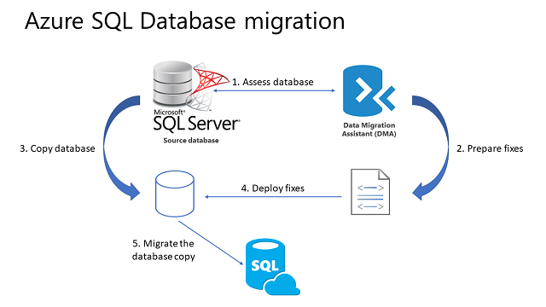
Migration Steps
Assess the database
Prepare any necessary fixes as Transact-SQL scripts.
Make a transitionally consistent copy of the source database.
Deploy the Transact-SQL scripts to apply the fixes to the database copy.
Migrate the database copy to a new Azure SQL Database.
Notes:
Assess the database for compatibility by using the latest version of the Data Migration Assistant (DMA).
Prepare any necessary fixes as Transact-SQL scripts.
Make a transactionally consistent copy of the source database being migrated or halt new transactions from occurring in the source database while migration is occurring. Methods to accomplish this latter option include disabling client connectivity or creating a database snapshot. After migration, you may be able to use transactional replication to update the migrated databases with changes that occur after the cutoff point for the migration. See Migrate using Transactional Migration.
Deploy the Transact-SQL scripts to apply the fixes to the database copy.
Migrate the database copy to a new Azure SQL Database by using the Data Migration Assistant.

Slide 8

Questions?

Slide 9
Lesson 2: Is your database ready to move to Azure SQL database?
Notes:
Lesson 2 covers the steps to assess whether your database is ready to migrate to Azure SQL Database.

Slide 10
Objectives
After completing this learning, you will be able to:
Analyze if your database is compatible for migration to Azure SQL Database.
Notes:
Lesson 2 covers the steps to assess whether your database is ready to migrate to Azure SQL Database.

Slide 11
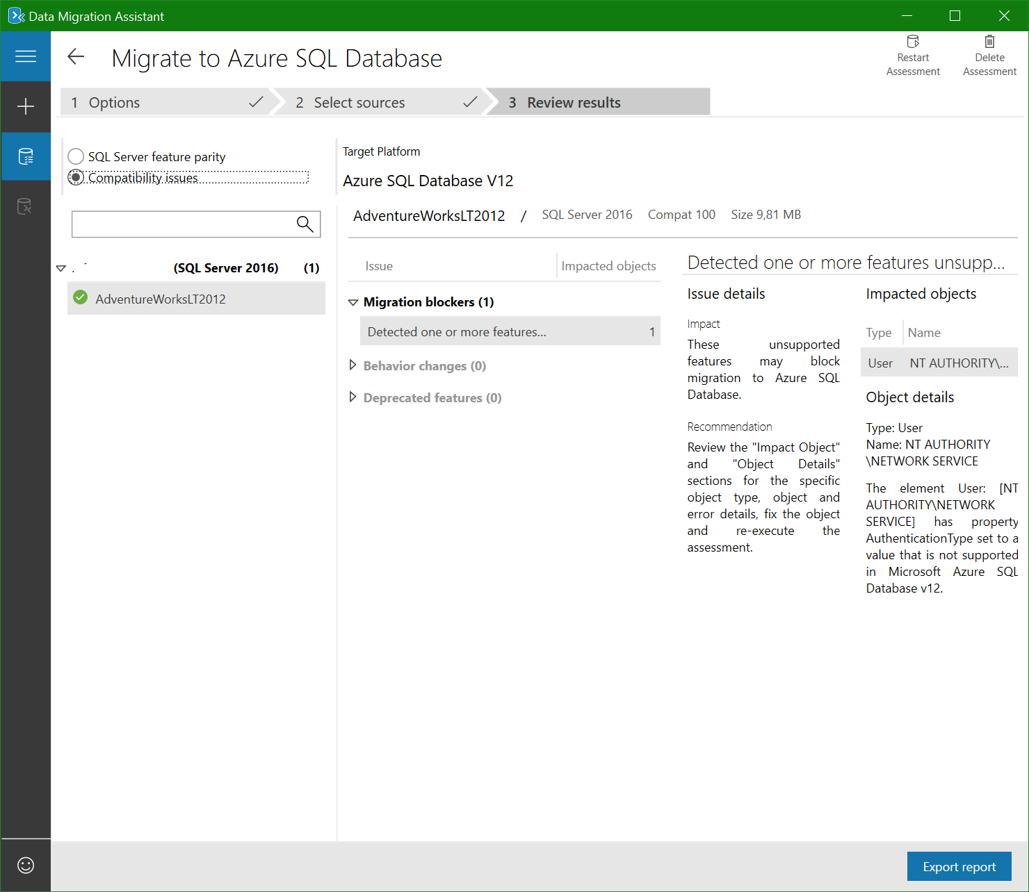
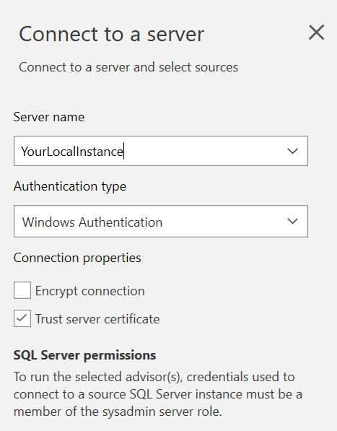
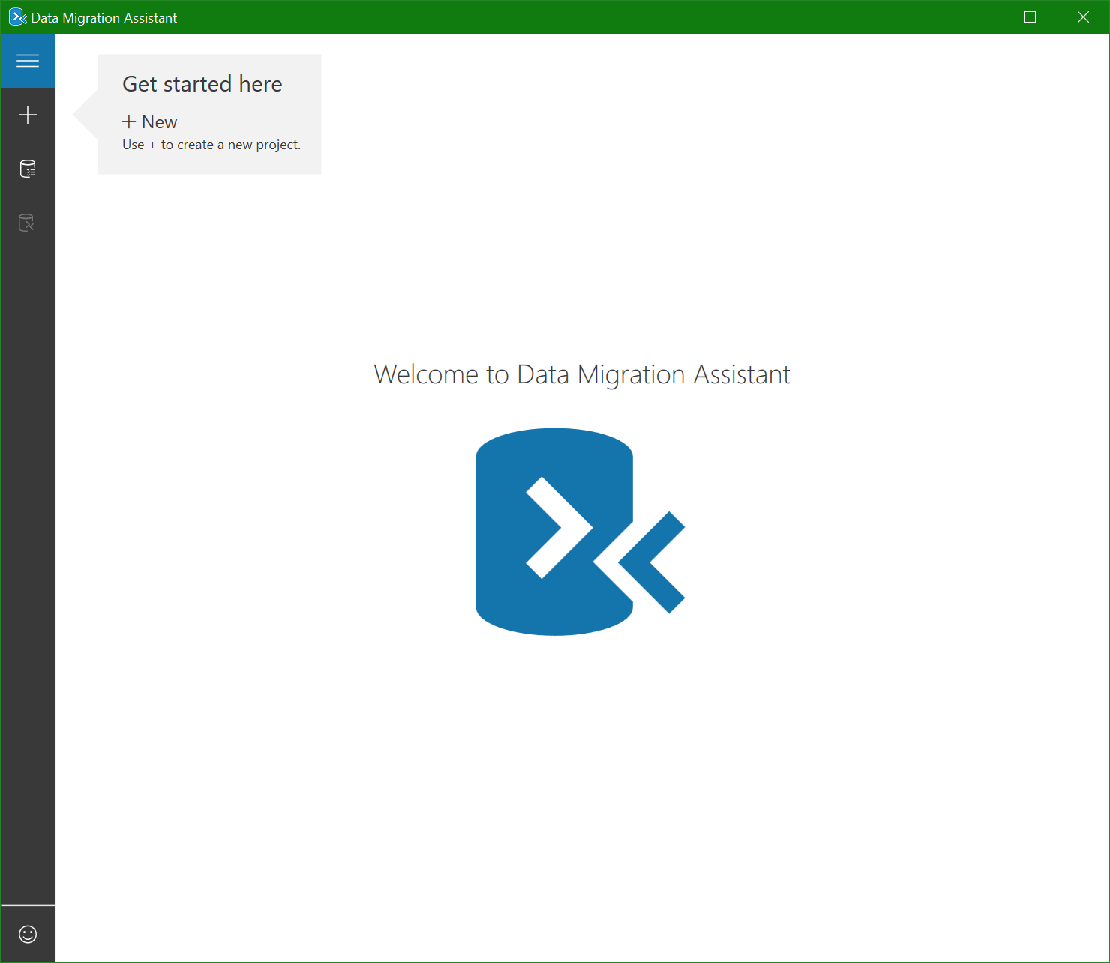
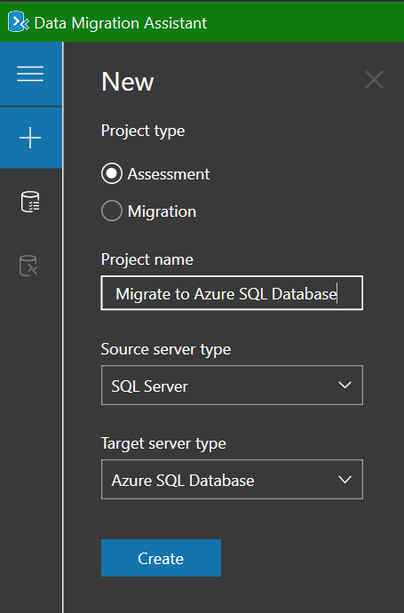
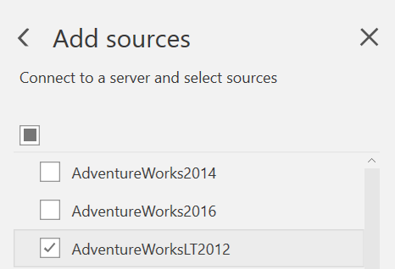
Determine Compatibility with DMA
Open Data Migration Assistant (DMA).
Create a new Assessment Project with Azure SQL Database Target.
Connect to local instance.
Select the source database(s).
Verify Compatibility Report.
Notes:
Analyze your database for compatibility with Azure SQL Database
The following step-by-step instructions help you perform your first assessment for migrating to on-premises SQL Server, SQL Server running on an Azure VM, or Azure SQL Database, by using Data Migration Assistant.
Perform a SQL Server migration assessment with Data Migration Assistant:
https://docs.microsoft.com/en-us/sql/dma/dma-assesssqlonprem?view=sql-server-2017

Slide 12

Demonstration
Verify your database for compatibility issues with DMA.
Notes:
M06L02Demo01
Demo setup instructions
The demo database pubs has to be installed on the VM or on your computer if you’re running a local instance.
The backup file of the database can be found in C:\Demos\M06L02Demo01 folder.
The latest version of the Data Migration Assistant https://www.microsoft.com/en-us/download/details.aspx?id=53595 should be installed
Steps
Open the DMA and create a new assessment project with target type Azure SQL Database
Connect to your on-premises instance and select the pubs database as source
Click the Start Assessment button
Wait until the assessment is finished and explain the SQL Server feature parity and the compatibility issues

Slide 13
Questions?

Slide 14
Lesson 3: Fix database migration compatibility issues
Notes:
This lesson covers the steps and tools to fix compatibility issues with your database before migration to Azure SQL Database.

Slide 15
Objectives
After completing this learning, you will be able to:
Choose which tools you can use to fix compatibility issues.
Notes:
This lesson covers the steps and tools to fix compatibility issues with your database before migration to Azure SQL Database.

Slide 16
Fix Database Migration Compatibility Issues
Compatibility issues must be fixed before proceeding with the SQL Server Database migration.
You can use DMA + Extended Events to evaluate any ad hoc or dynamic SQL queries or any DML statements initiated through the application data layer.
Use the following resources:
A wide variety of compatibility issues.
SQL Server database features not supported in Azure SQL Database
Discontinued Database Engine Functionality in SQL Server 2019
Discontinued Database Engine Functionality in SQL Server 2017
Discontinued Database Engine Functionality in SQL Server 2016
Discontinued Database Engine Functionality in SQL Server 2014
Discontinued Database Engine Functionality in SQL Server 2012
Discontinued Database Engine Functionality in SQL Server 2008 R2
Notes:
If compatibility issues are detected, you must fix them before proceeding with the Azure SQL database migration. There are a wide variety of compatibility issues that you might encounter, depending both on the version of SQL Server in the source database and the complexity of the database you are migrating. Older versions of SQL Server have more compatibility issues. Use the following resources, in addition to a targeted Internet search using your search engine of choices:
SQL Server database features not supported in Azure SQL Database
Discontinued Database Engine Functionality in SQL Server 2019
Discontinued Database Engine Functionality in SQL Server 2017
Discontinued Database Engine Functionality in SQL Server 2016
Discontinued Database Engine Functionality in SQL Server 2014
Discontinued Database Engine Functionality in SQL Server 2012
Discontinued Database Engine Functionality in SQL Server 2008 R2

Slide 17
Questions?

Slide 18
Lesson 4: Identify the right Azure SQL Database SKU
Notes:
This lesson covers the steps to right size your Azure SQL Database using the current SQL Server metrics.

Slide 19
Objectives
After completing this learning, you will be able to:
Right size your Azure SQL Database using the current SQL Server metrics.
Notes:
This lesson covers the steps to right size your Azure SQL Database using the current SQL Server metrics.

Slide 20
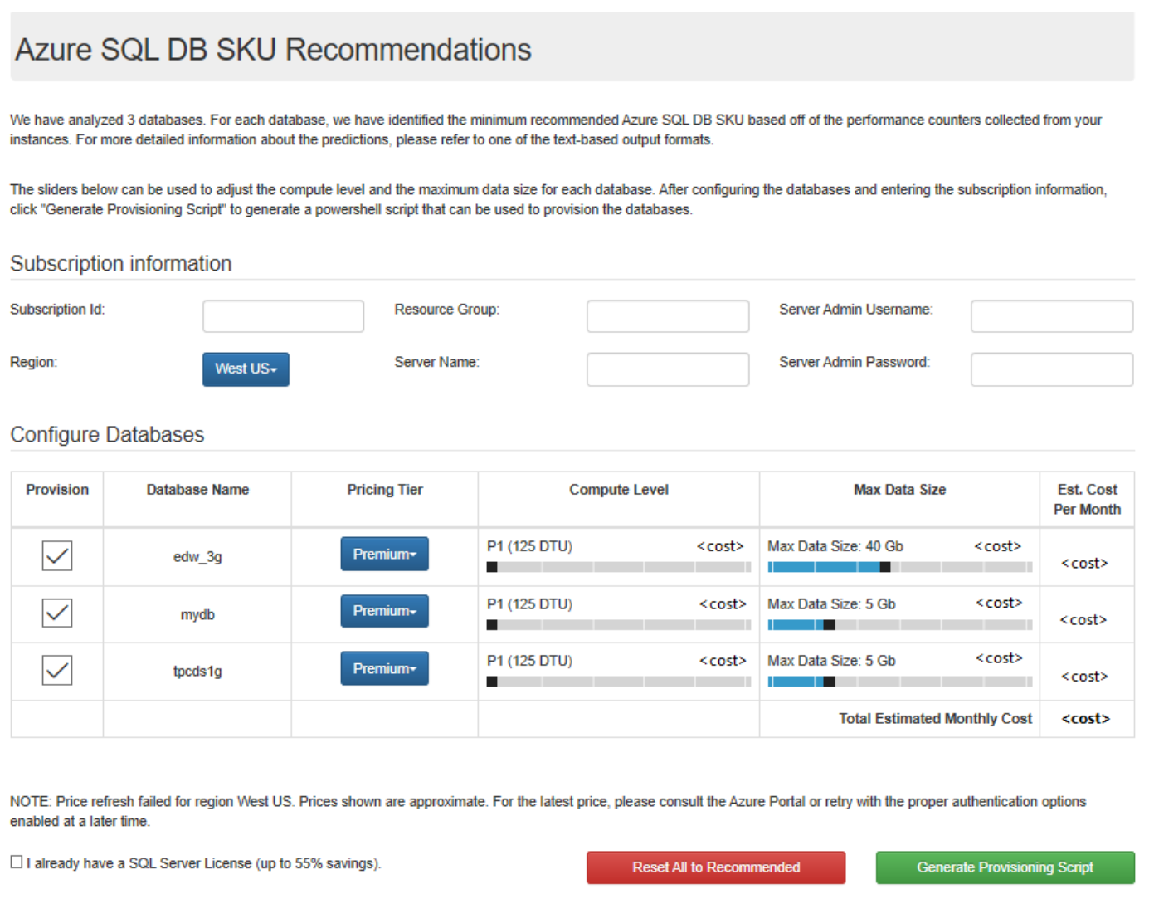
Identify the right Azure SQL Database SKU for your on-premises database
Database Migration Assistant: (DMA)
Provides SKU recommendations in a user-friendly output based on performance counters collected from the computer(s) hosting your databases.
It has several deployment options, including:
Single database
Elastic pools
Managed instance
Notes:
Migrating databases to the cloud can be complicated, especially when trying to select the best Azure database target and SKU for your database. Our goal with the Database Migration Assistant (DMA) is to help address these questions and make your database migration experience easier by providing these SKU recommendations in a user-friendly output.
DMA's Azure SQL Database SKU recommendations feature. Azure SQL Database has several deployment options, including:
Single database
Elastic pools
Managed instance

Slide 21
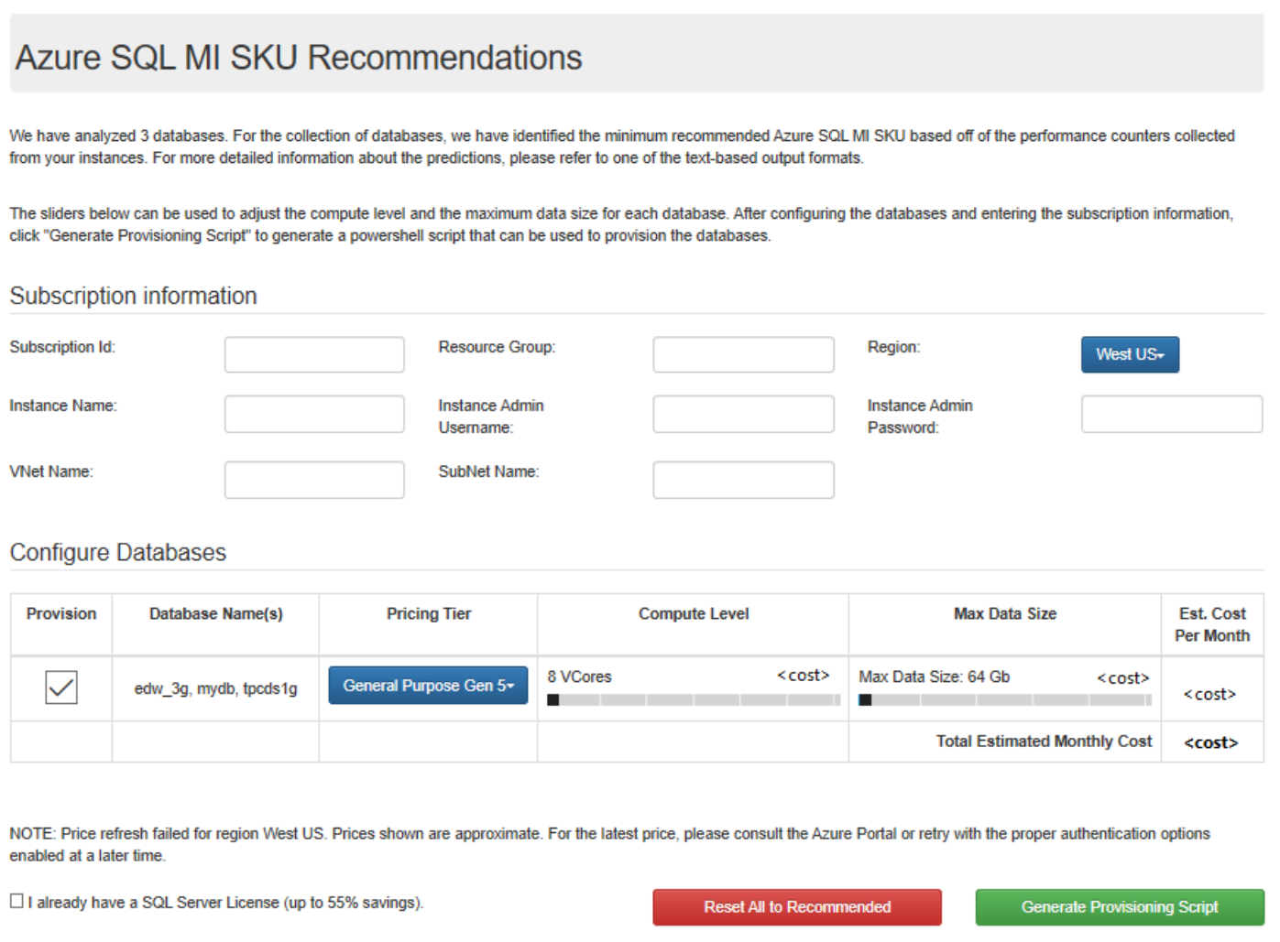
Identify the right Azure SQL Database SKU for your on-premises database (continued)
This feature provides recommendations related to:
pricing tier
compute level
max data size
estimated cost per month.
Furthermore, it offers the ability to bulk provision single databases and managed instances in Azure for all recommended databases.
Notes:
The SKU Recommendations feature allows you to identify both the minimum recommended Azure SQL Database single database or managed instance SKU based on performance counters collected from the computer(s) hosting your databases. The feature provides recommendations related to pricing tier, compute level, and max data size, as well as estimated cost per month. It also offers the ability to bulk provision single databases and managed instances in Azure for all recommended databases.

Slide 22
Questions?

Slide 23
Lesson 5: Migrate a compatible SQL Server database to Azure SQL Database
Notes:
This lesson covers the steps to migrate your compatible database to Azure SQL Database.

Slide 24
Objectives
After completing this learning, you will be able to:
Migrate your compatible on-premises database to Azure SQL Database.
Notes:
This lesson covers the steps to migrate your compatible database to Azure SQL Database.

Slide 25
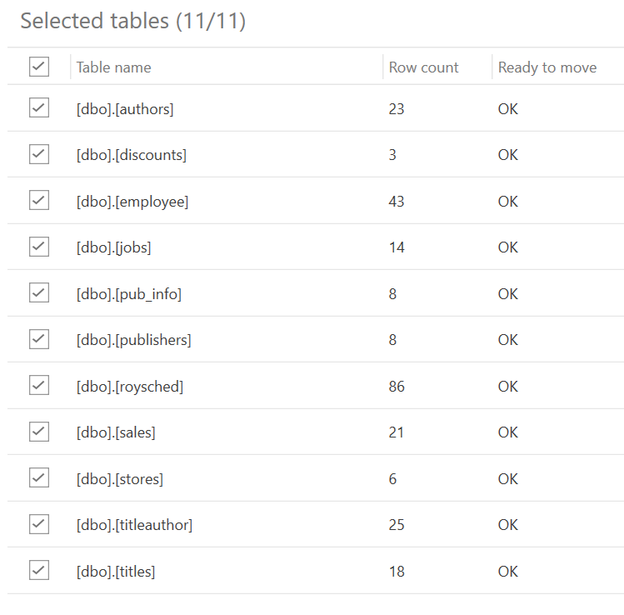
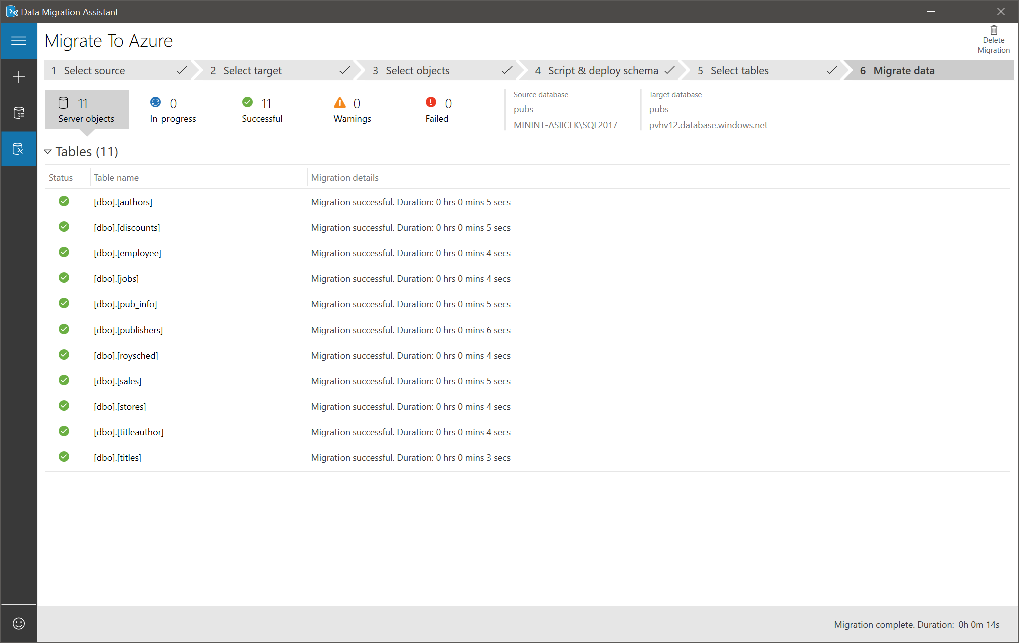
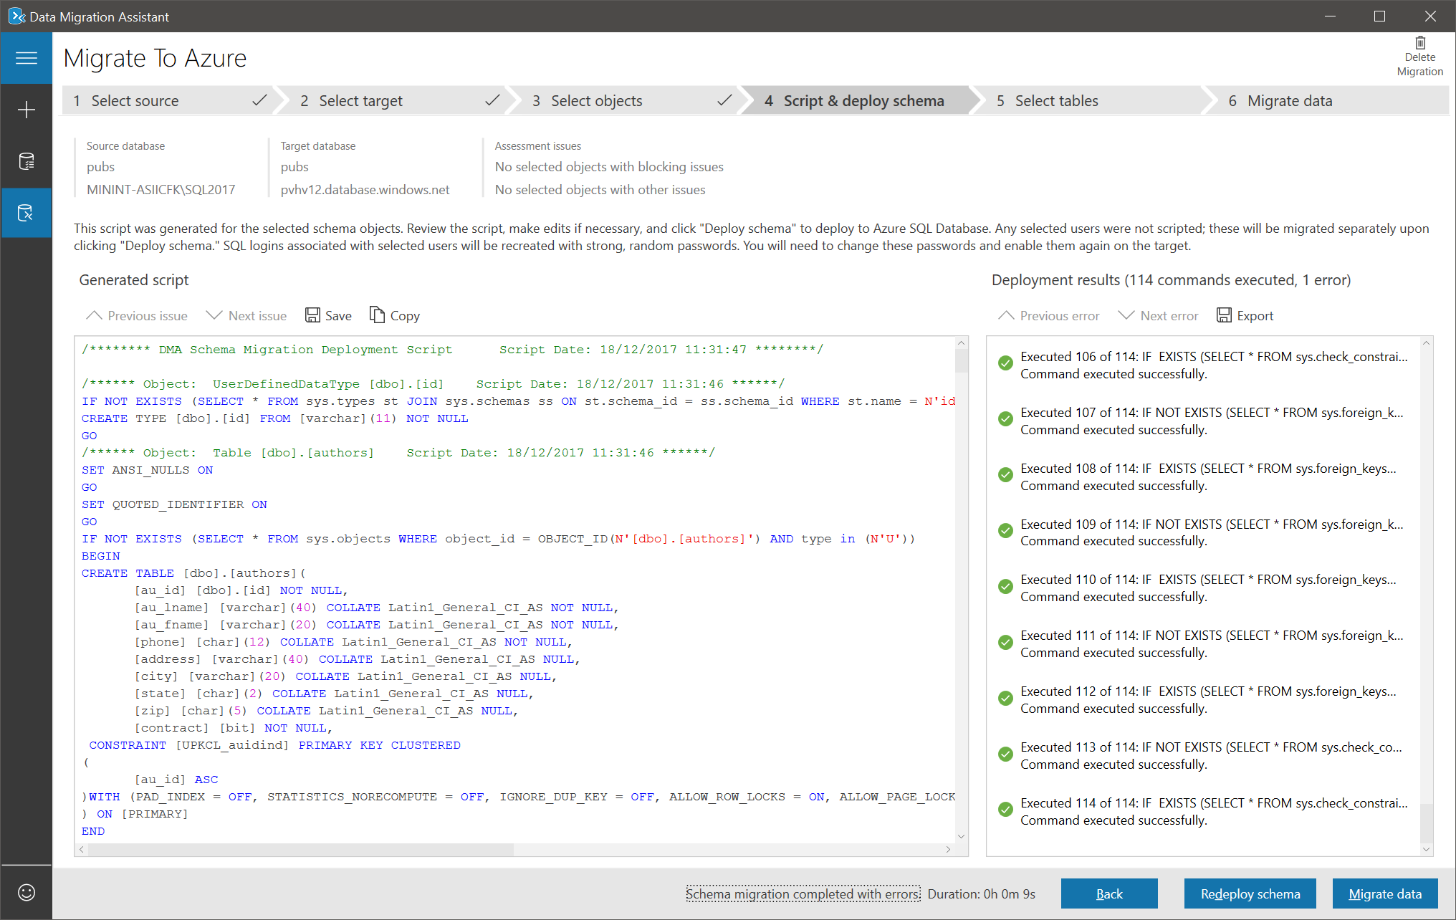
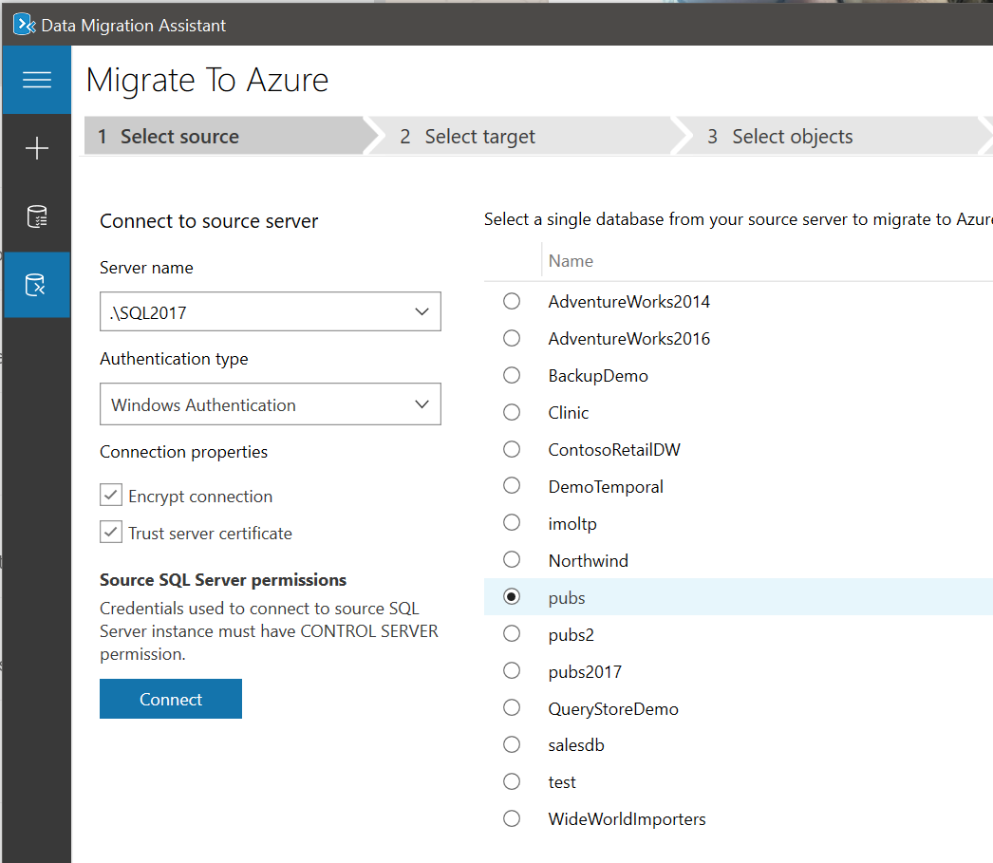
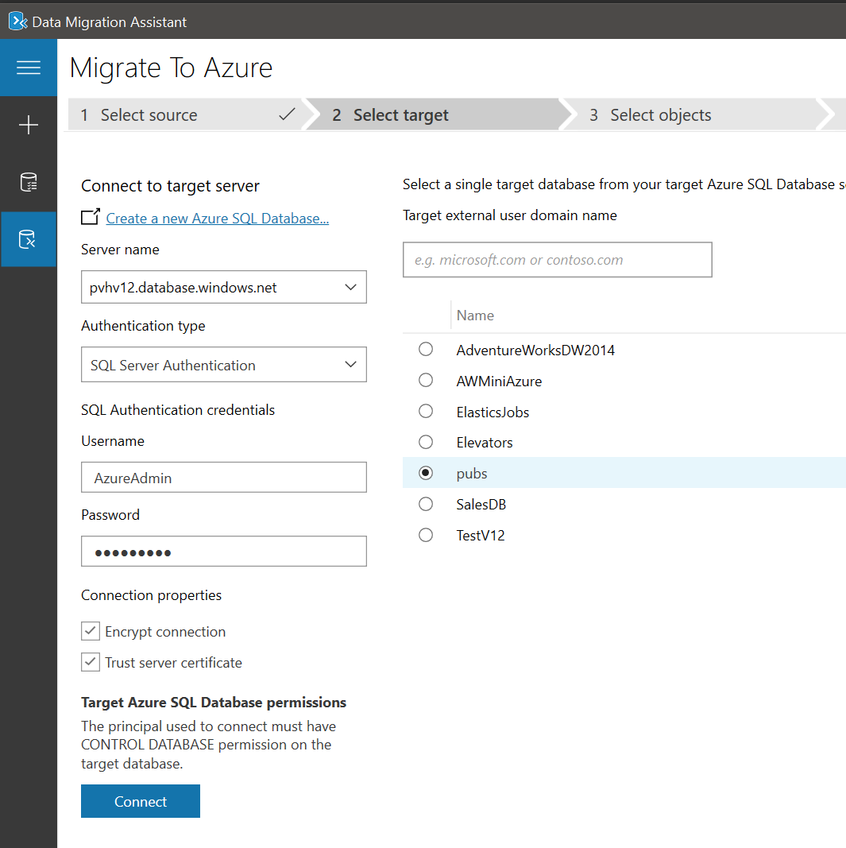
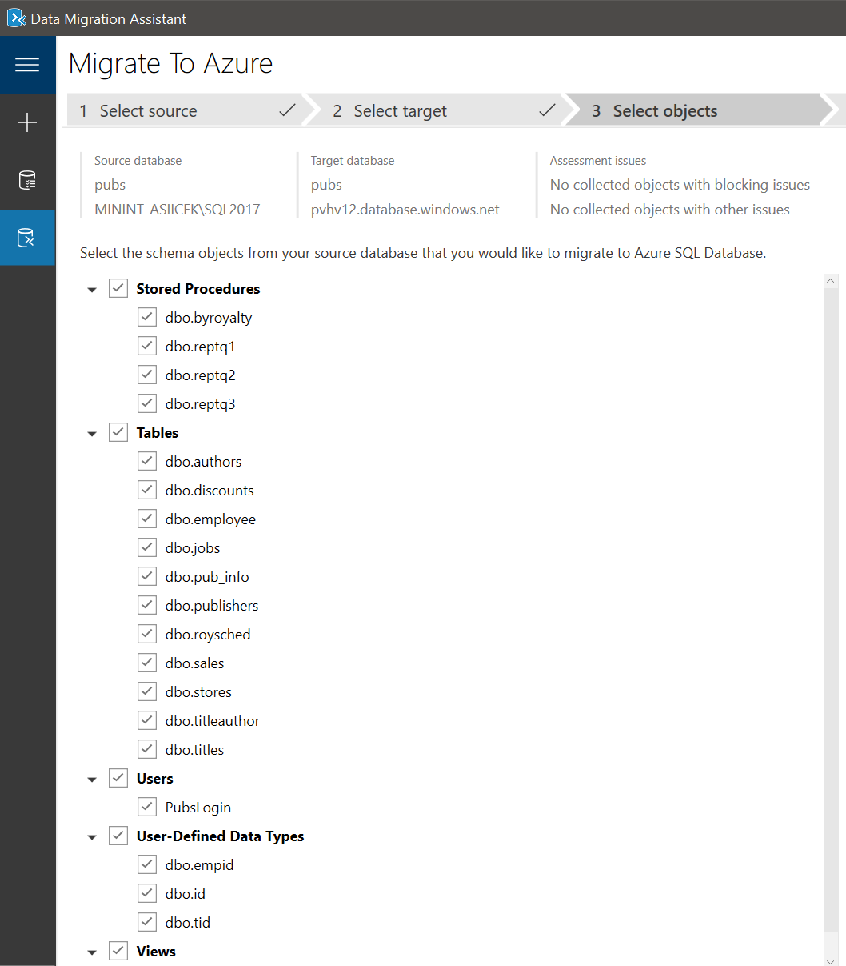
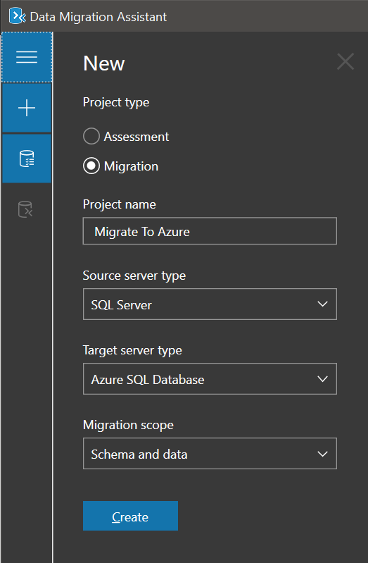
Migration Methods – DMA
Create a new migration project.
Connect to the Source.
Select the Target.
Select the objects & users to migrate.
Script & Deploy Schema.
Select tables & migrate data.
Notes:
The Data Migration Assistant provides migrations to Azure SQL Database. The article below provides step-by-step instructions for migrating SQL Server on-premises to Azure SQL Database by using the Data Migration Assistant.
Migrate on-premises SQL Server or SQL Server on Azure VMs to Azure SQL Database using the Data Migration Assistant:
https://docs.microsoft.com/en-us/sql/dma/dma-migrateonpremsqltosqldb?view=sql-server-2017

Slide 26
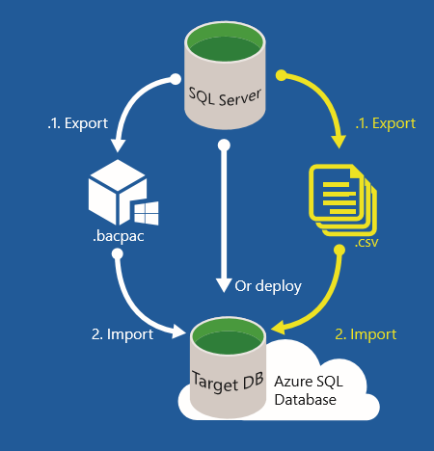
Migration Methods – Export/Import with DACPAC File and BCP
Used for much larger databases to achieve greater parallelization for increased performance.
Migrate the schema and the data separately:
Export the schema only to a DACPAC file.
Import the schema only from the DACPAC File into SQL Database.
Use BCP to extract the data into flat files and then parallel load these files into the Azure SQL Database.
Investigate using SQLPackage.exe
Notes:
There are two methods for Export/Import of larger databases to migrate to Azure SQL Database:
Using BACPAC file for schema and data migration
Using BACPAC file for schema migration and BCP for data migration
1. Export to BACPAC File and then Import from BACPAC File: If you have connectivity challenges (no connectivity, low bandwidth, or timeout issues) and for medium to large databases, use a BACPAC file. With this method, you export the SQL Server schema and data to a BACPAC file. You then import the BACPAC file into SQL Database using the Export Data Tier Application Wizard in SQL Server Management Studio or the SqlPackage command-prompt utility.
2. Use BACPAC and BCP together: Use a BACPAC file and BCP for much larger databases to achieve greater parallelization for increases performance, albeit with greater complexity. With this method, migrate the schema and the data separately.
Export the schema only to a BACPAC file.
Import the schema only from the BACPAC File into SQL Database.
Use BCP to extract the data into flat files and then parallel load these files into Azure SQL Database.
Discuss the use of SQLPackage.exe
https://docs.microsoft.com/en-us/sql/tools/sqlpackage?view=sql-server-ver15

Slide 27
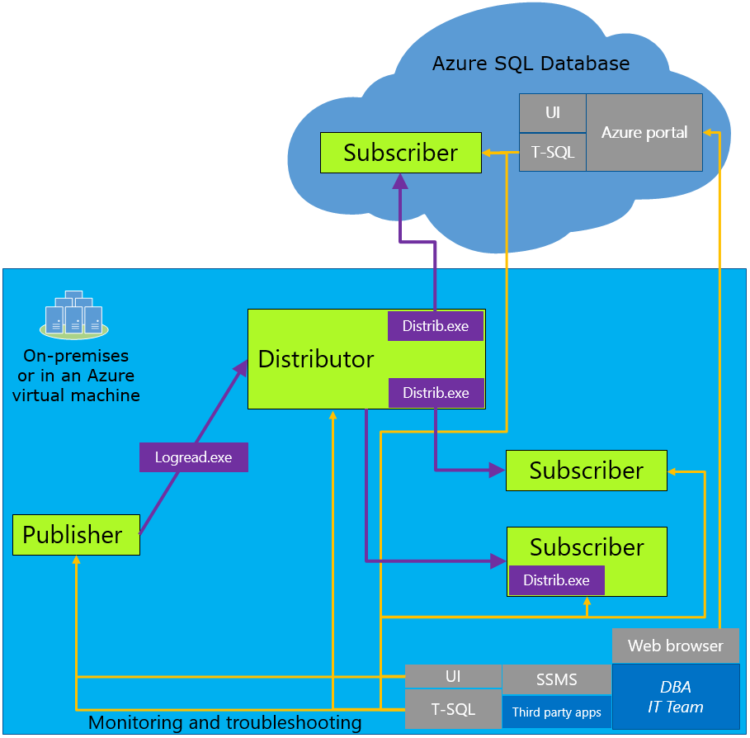
Transactional Replication
Used will have minimal downtime during migration.
Configure your Azure SQL Database as a subscriber.
All changes to your data or schema show up in your Azure SQL Database.
Synchronization is complete – change the connection string of your application.
Remove Replication.
Notes:
Understanding the Transactional Replication architecture
When you cannot afford to remove your SQL Server database from production while the migration is occurring, you can use SQL Server transactional replication as your migration solution. To use this solution, you configure your Azure SQL Database as a subscriber to the on-premises SQL Server instance that you wish to migrate. The on-premises transactional replication distributor synchronizes data from the on-premises database to be synchronized (the publisher) while new transactions continue to occur.
With transactional replication, all changes to your data or schema show up in your Azure SQL Database. Once the synchronization is complete and you are ready to migrate, change the connection string of your applications to point them to your Azure SQL Database. Once transactional replication drains any changes left on your on-premises database and all your applications point to the Azure SQL Database, you can uninstall transactional replication. Your Azure SQL Database is now your production system.
How Transactional Replication works
Transactional replication involves 3 main components. They are the publisher, the distributor and the subscriber. Together these components carry out replication. The distributor is responsible for controlling the processes which move your data between servers. When you set up distribution, SQL will create a distribution database. Each publisher needs to be tied to a distribution database. The distribution database holds the metadata for each associated publication and data on the progress of each replication. For transaction replication it will hold all the transactions than need to be executed in the subscriber.
The publisher is the database where all data for migration originates. Within the publisher there can be many publications. These publications contain articles which map to all the tables and data that need to be replicated. Depending on how you define the publication and articles you can replicate either all or part of your database.
In replication the subscriber is the server which receives all the data and transactions from the publication. Each publication can have many subscribers.
Some tips and differences for migrating to SQL Database
Using a local distributor:
This will cause a performance impact on the server.
If the performance impact is unacceptable you can use another server but it will add complexity in management and administration.
When selecting a snapshot folder make sure the folder you select is large enough to hold a BCP of every table you want to replicate.
Note that snapshot creation will lock the associated tables until it is complete, keep this in mind when scheduling your snapshot.
Only “push” subscriptions are supported in Azure SQL Database (“pull” subscriptions not supported)
i.e. You can only add subscribers from the side of your on-premises database

Slide 28
Migration Methods – Data Migration Service
Fully managed, reliable and seamless, migration service for both operational databases and data warehouses.
Minimal down time migrations.
Homogeneous and heterogeneous source-target pairs.
Notes:
The Azure Database Migration Service (DMS) is a fully managed service designed to enable seamless migrations from multiple database sources to Azure Data platforms with minimal downtime.
Migrate databases to Azure with familiar tools
The Azure Database Migration Service integrates some of the functionality of Microsoft’s existing tools and services. It provides customers with a comprehensive, highly available solution. The service uses the Data Migration Assistant to generate assessment reports that provide recommendations to guide you through the changes required prior to performing a migration. It's up to you to perform any remediation required. When you are ready to begin the migration process, the Azure Database Migration Service performs all of the required steps. You can fire and forget your migration projects with peace of mind, knowing that the process takes advantage of best practices as determined by Microsoft.
Different migration options
Migrate SQL Server to Azure SQL Database offline
Migrate SQL Server to Azure SQL Database online
Migrate SQL Server to Azure SQL Database Managed Instance offline
(Migrate MySQL to Azure Database for MySQL online) not related to this workshop

Slide 29
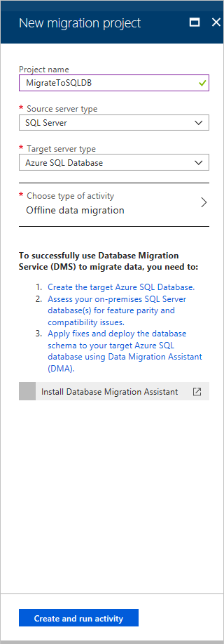
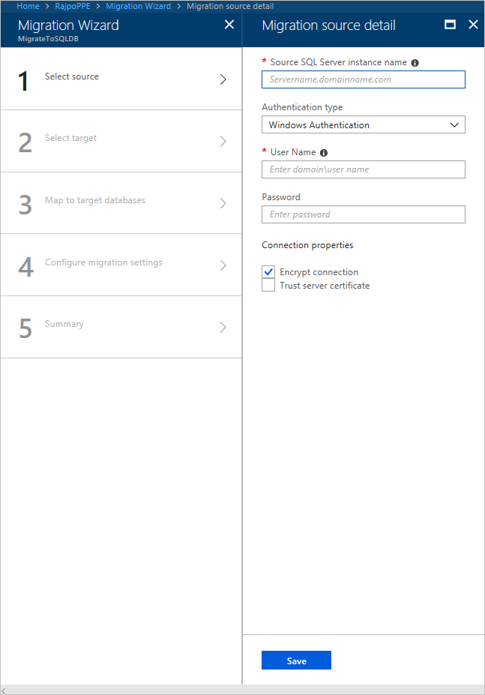
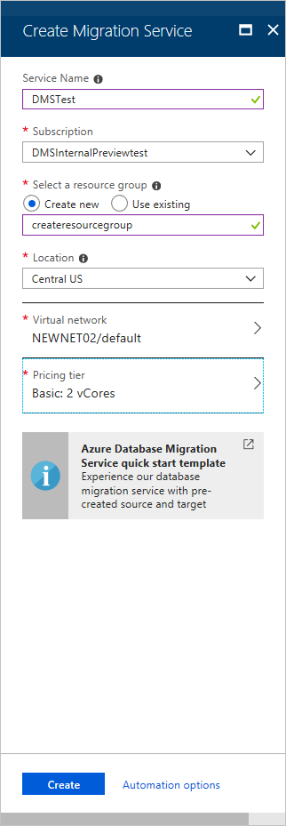
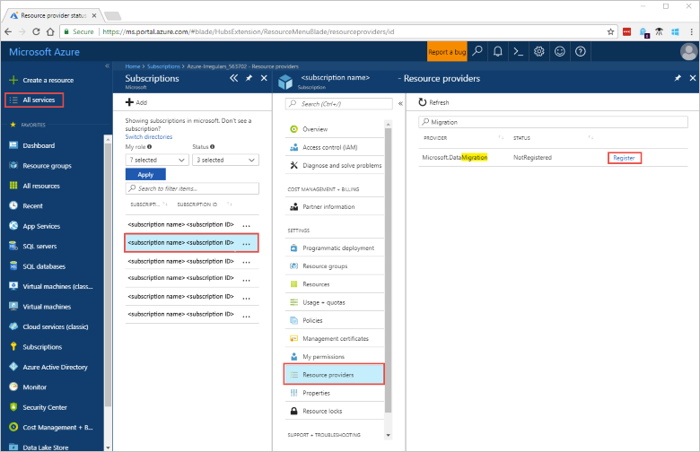
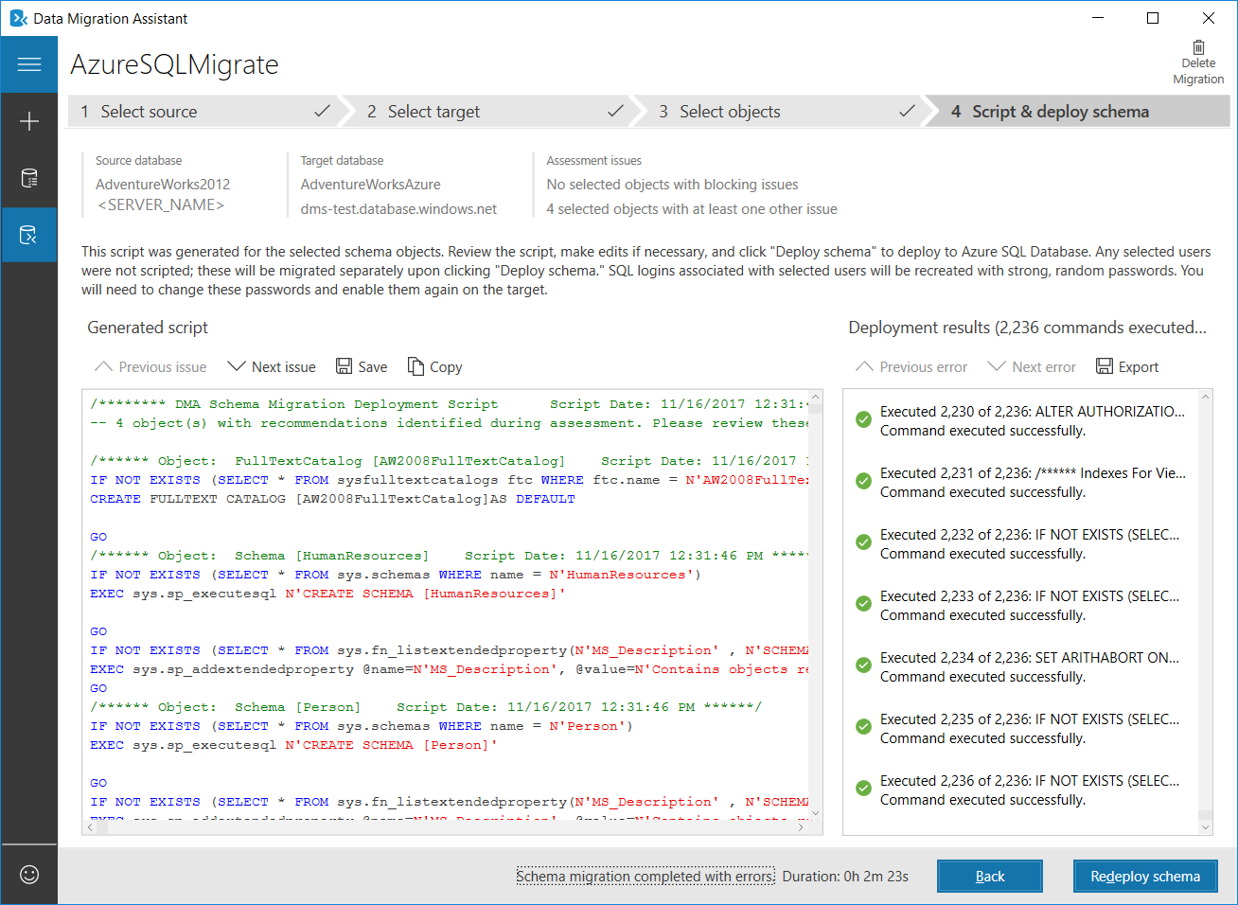
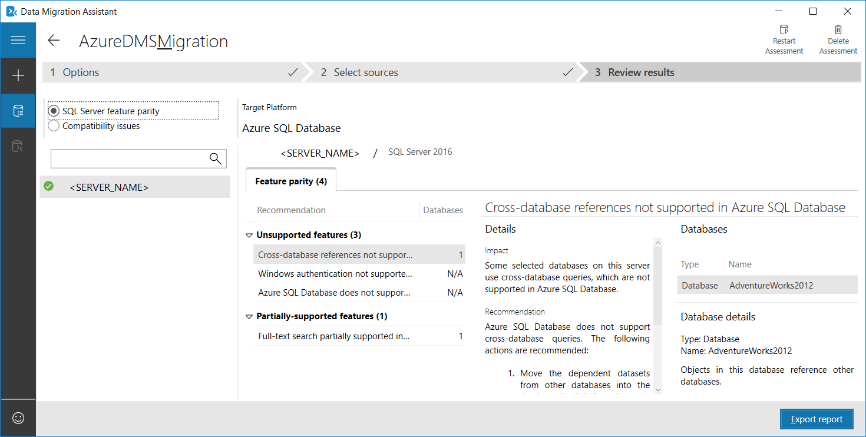
Migration Methods – DMS
Register the resource provider.
Create an instance of the service.
Assess your on-premises database.
Migrate the sample schema.
Create a Migration Project.
Specify Source Details.
Notes:
1. Register the resource provider
Register the Microsoft.DataMigration resource provider before you create your first instance of the Database Migration Service.
In the Azure portal, select All services, and then select Subscriptions. Select the subscription in which you want to create the instance of the Azure Database Migration Service, and then select Resource providers. Search for migration, and then to the right of Microsoft.DataMigration, select Register.
2. Create an instance of the service
Select +Create a resource to create an instance of the Azure Database Migration Service. Search the marketplace for "migration", select Azure Database Migration Service, and then on the Azure Database Migration Service screen, select Create.
3. Assess your on-premises database
Before you can migrate data from an on-premises SQL Server instance to Azure SQL Database, you need to assess the SQL Server database for any blocking issues that might prevent migration using DMA.
4. Migrate the sample schema
After you are comfortable with the assessment and satisfied that the selected database is a viable candidate for migration to Azure SQL Database, use the Data Migration Assistant to migrate the schema to Azure SQL Database.
5. Create a migration project
After the service is created, locate it within the Azure portal, open it, and then create a new migration project.
In the Azure portal, select All services, search for Azure Database Migration Service, and then select Azure Database Migration Services. On the Azure Database Migration Services screen, search for the name of the Azure Database Migration Service instance that you created, and then select the instance. Select + New Migration Project.
6. Specify Source Details
On the Migration source detail screen, specify the connection details for the source SQL Server instance.
Make sure to use a Fully Qualified Domain Name (FQDN) for the source SQL Server instance name. You can also use the IP Address for situations in which DNS name resolution is not possible.

Slide 30
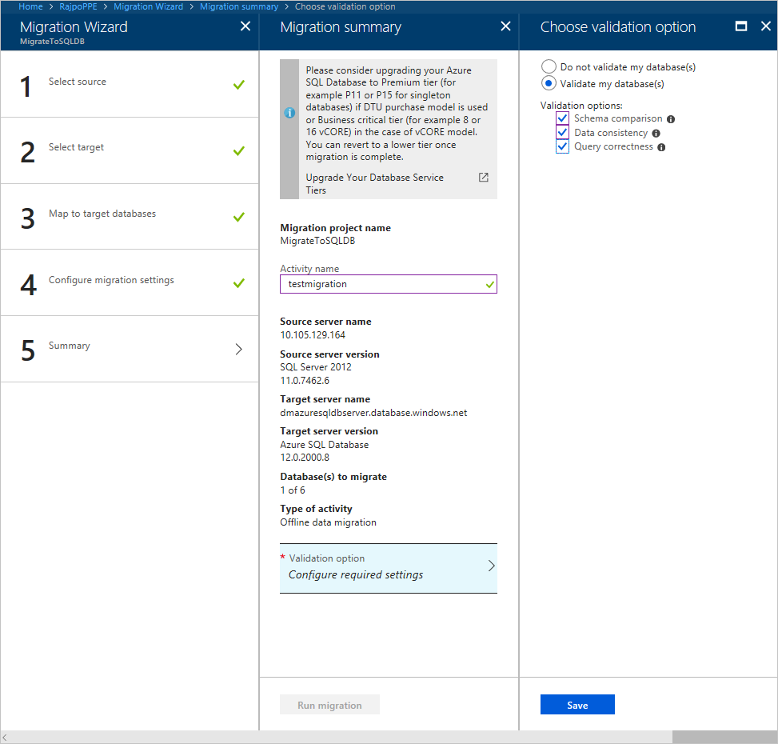
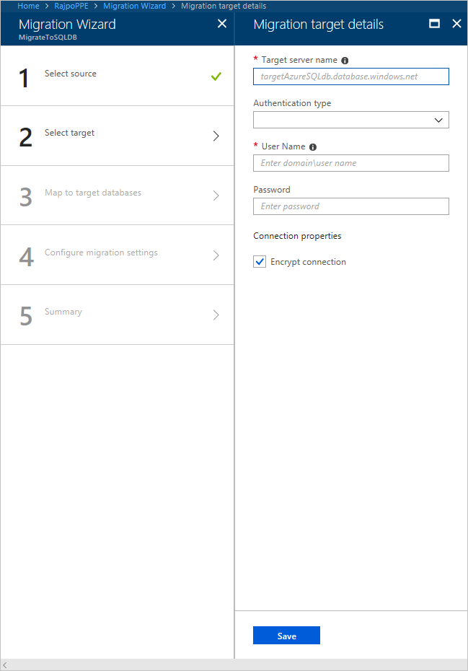
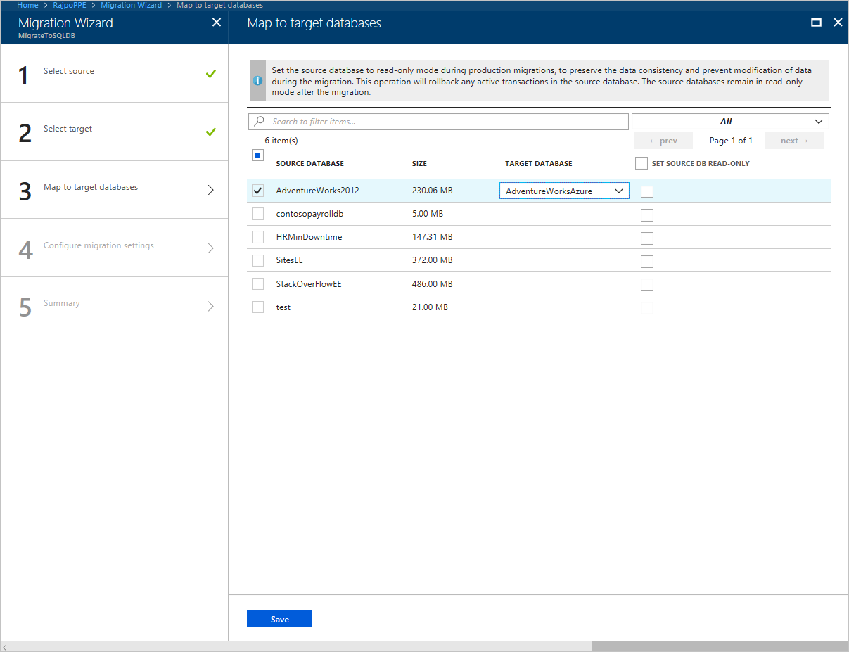
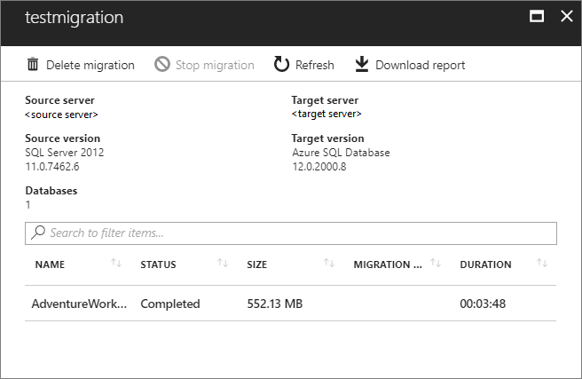
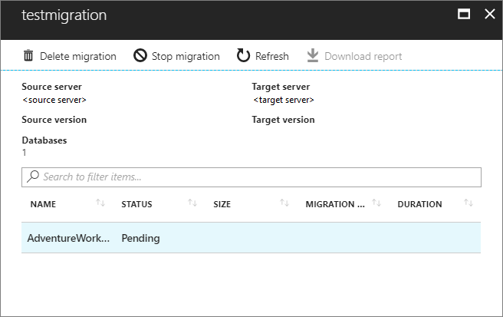
Migration Methods – DMS (continued)
Specify Target Details
Map to Target Databases
Choose validation Option
Run the Migration
Monitor the Migration
Notes:
1. Specify Target Details
Select Save, and then on the Migration target details screen, specify the connection details for the target Azure SQL Database Server, which is the pre-provisioned Azure SQL Database to which the AdventureWorks2012 schema was deployed by using the Data Migration Assistant
2. Map to Target Databases
Select Save, and then on the Map to target databases screen, map the source and the target database for migration. If the target database contains the same database name as the source database, the Azure Database Migration Service selects the target database by default.
3. Choose validation Option
Expand the Validation option section to display the Choose validation option screen, and then specify whether to validate the migrated databases for Schema comparison, Data consistency, and Query correctness.
4. Run the Migration
Select Run migration. The migration activity window appears, and the Status of the activity is Pending.
5. Monitor the Migration
On the migration activity screen, select Refresh to update the display until the Status of the migration shows as Completed. After the migration completes, select Download report to get a report listing the details associated with the migration process. Verify the target database(s) on the target Azure SQL Database server.

Slide 31
Optimizing data transfer performance during migration
Choose the highest service level and performance tier.
Minimize the distance between your BACPAC file and the destination data center.
Disable auto-statistics during migration.
Partition tables and indexes.
Drop indexed views and recreate them once finished.
Notes:
Optimizing data transfer performance during migration
The following list contains recommendations for best performance during the import process:
Choose the highest service level and performance tier that your budget allows to maximize the transfer performance. You can scale down after the migration completes to save money.
Minimize the distance between your BACPAC file and the destination data center.
Disable auto-statistics during migration
Partition tables and indexes
Drop indexed views, and recreate them once finished
Optimize performance after the migration completes
Update statistics with full scan after the migration is completed.

Slide 32
Demonstration
Migration Methods – DMA
Migrate your on-premises database with DMA.
Migrate your on-premises database with DMS Hybrid mode.
Notes:
M06L05Demo01
Demo setup instructions – Demo1
Make sure that the on-premises database pubs is compatible with Azure SQL Database. To be sure execute the script below if not done before
USE pubs
GO
ALTER VIEW [dbo].[titleview]
AS
select title, au_ord, au_lname, price, ytd_sales, pub_id
from authors
join titleauthor
on authors.au_id = titleauthor.au_id
join titles
ON titles.title_id = titleauthor.title_id
GO
Make sure that you have removed previous versions of the pubs database on your logical Azure Server.
Create a new blank database “pubs” on your Logical Server in Azure
The latest version of the Data Migration Assistant https://www.microsoft.com/en-us/download/details.aspx?id=53595 should be installed
SSMS
Steps
Open the DMA and create a new Migration Project
Specify the following properties or the project
Project Name – MigrateToAzure
Source server type – SQL Server
Target Server type – Azure SQL Database
Migration Scope – Schema and data
Specify the source server. This should be your “on-prem” instance
Click connect, select the pubs database from the list and click next
Specify the target server. This should be your logical server in Azure
Fill in the SQL Server Authentication credentials, click connect and select the pubs database from the list.
In the select objects tab, you will notice that the dbo.titleview and the pub_info returns a warning. Explain to the students and press the Apply All Changes Button
Click on “Generate SQL Script”
Click on Deploy Schema to deploy the schema in your Azure SQL DB
Wait until the deployment is finished and review with SSMS
Go back to DMA and click on Migrate Data
All tables will be selected by default. Click on Start Data Migration
Review the content of the tables in your Azure SQL DB.
Demo setup instructions – Demo2
Log on to Azure portal
Register the Microsoft.DataMigration resource provider (if you have not done it yet)
In the Azure portal, select Subscriptions, select the subscription in which you want to create the instance of Azure Database Migration Service, and then select Resource providers.
Search for migration, and then to the right of Microsoft.DataMigration, select Register.
Create an instance of the service
Select +Create a resource to create an instance of Azure Database Migration Service.
Search the marketplace for "migration", select Azure Database Migration Service, and then on the Azure Database Migration Service screen, select Create.
On the Create Migration Service screen:
Choose a Service Name that is memorable and unique to identify your instance of Azure Database Migration Service.
Select the Azure Subscription in which you want to create the instance.
Select an existing Resource Group or create a new one.
Choose the Location that is closest to your source or target server.
Note: This service is currently under preview and during this period, hybrid mode is supported only in the East US region. Since the hybrid worker is installed in your on-premises network, there is little or no impact on performance even if you are migrating to a target in a different region
For Service mode, select Hybrid (Preview).
Select Review + create.
On the Review + create tab, review the Terms, verify the other information provided, and then select Create.
After a few moments, your instance of Azure Database Migration Service in hybrid mode is created and ready to set up.
After the service created, select Properties, and then copy the value displayed in the Resource Id box, which you will use to install the Azure Database Migration Service hybrid worker.
Create Azure App registration ID
In the Azure portal, select Azure Active Directory, select App registrations, and then select New registration.
Specify a name for the application, and then, under Supported account types, select the type of accounts to support to specify who can use the application.
Use the default values for the Redirect URI (optional) fields, and then select Register.
After App ID registration is completed, make a note of the Application (client) ID, which you'll use while installing the hybrid worker.
In the Azure portal, navigate to Azure Database Migration Service, select Access control (IAM), and then select Add role assignment to assign contributor access to the App ID.
Select Contributor as the role, assign access to Azure AD user, or service principal, and then select the App ID name.
Select Save to save the role assignment for the App ID on the Azure Database Migration Service resource.
Download and install the hybrid worker
In the Azure portal, navigate to your instance of Azure Database Migration Service.
Under Settings, select Hybrid, and then select Installer download to download the hybrid worker.
Extract the ZIP file on the server that will be hosting the Azure Database Migration Service hybrid worker.
In the install folder, locate and open the dmsSettings.json file, specify the ApplicationId and resourceId, and then and save the file.
Generate a certificate that Azure Database Migration Service can use to authenticate the communication from the hybrid worker.
Open CMD with admin rights > navigate to the install folder (the folder you have extracted the content of the ZIP file) > run the following command DMSWorkerBootstrap.exe -a GenerateCert
Note: Check if the certificate is generated in the Install folder.
In the Azure portal, navigate to the App ID, under Manage, select Certificated & secrets, and then select Upload certificate to select the public certificate you just generated.
Install the Azure Database Migration Service hybrid worker on your on-premises server.
Open CMD with admin rights > navigate to the install folder (the folder you have extracted the content of the ZIP file) > run the following command DMSWorkerBootstrap.exe -a Install –IAcceptDMSLicenseTerms
If the installer runs without error, then the service will show an online status in Azure Database Migration Service and you're ready to migrate your databases.
More details can be found here: https://docs.microsoft.com/en-us/azure/dms/quickstart-create-data-migration-service-hybrid-portal

Slide 33
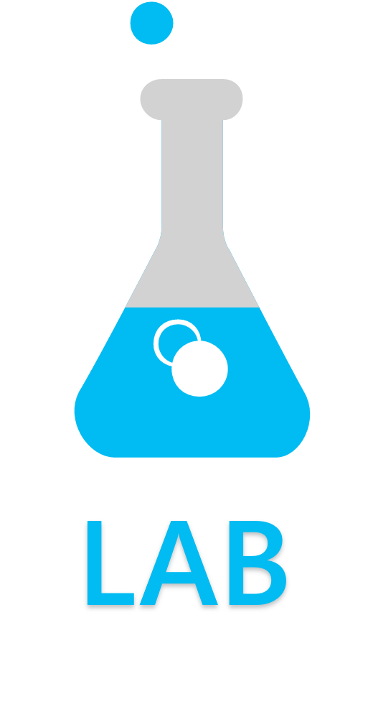
Migrate a Compatible SQL Server Database to Azure SQL Database
Exercise 1: Analyze your SQL Server Database for compatibility issues
Exercise 2: Fix database migration compatibility issues
Exercise 3: Migrate a database to Azure with Data Migration Assistant
Exercise 4: Migrate a database to Azure with SSMS
Exercise 5: Migrate a database to Azure with Transactional Replication
Notes:
M06L05Lab01

Slide 34
Questions?

Slide 35
Knowledge Check
What are the different migration methods that you can use to migrate your on-premises database to Azure SQL Database?
How is the fully managed service designed to enable seamless migrations called?
“I want to migrate my on-premises database to Azure SQL Database. The migration downtime can only be a few minutes.” Which migration method should I use?
Notes:
Q1:What are the different migration methods that you can use to migrate your on-premises database to Azure SQL Database?
Answer 1:
DMA
Use BACPAC and BCP together
Transactional Replication
DMS
Q2: How is the fully managed service designed to enable seamless migrations called?
Answer 2:
DMS
Q3: “I want to migrate my on-premises database to Azure SQL Database. The migration downtime can only be a few minutes. Which migration method should I use?”
Answer 3:
DMS online
Transaction Replication

Slide 36
Lesson 6: Sync data across multiple cloud and on-premises databases
Notes:
This lesson describes the Data Sync feature of Azure SQL Database.

Slide 37
Objectives
After completing this learning, you will be able to:
Describe what SQL Data Sync is.
Describe when you should use it.
Explain how Data Sync Works.
Notes:
This lesson describes the Data Sync feature of Azure SQL Database.

Slide 38
What is SQL Data Sync?
SQL Data Sync is a service built on Azure SQL Database that lets you synchronize the data you select bi-directionally across multiple SQL databases and SQL Server instances.
Notes:
Data Sync is based around the concept of a Sync Group. A Sync Group is a group of databases that you want to synchronize.
Data Sync uses a hub and spoke topology to synchronize data. You define one of the databases in the sync group as the Hub Database (must be an Azure SQL Database). The rest of the databases are member databases (either SQL Databases, on-premises SQL Server databases, or SQL Server instances on Azure VMs).
Sync occurs only between the Hub and individual members.
As part of this topology we also have a Sync Database which contains the metadata and log for Data Sync (this database has to be an Azure SQL Database located in the same region as the Hub Database).
Important
Azure SQL Data Sync does not support Azure SQL Database Managed Instance as of March 2019. Check for the latest update here: https://docs.microsoft.com/en-us/azure/sql-database/sql-database-sync-data

Slide 39
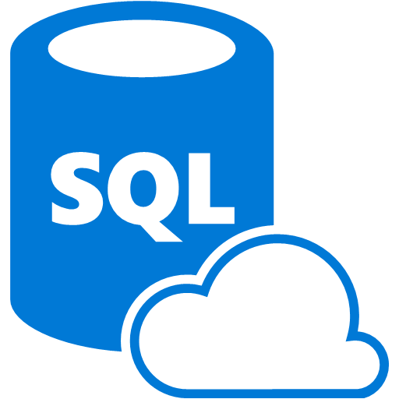
What is SQL Data Sync
Sync Group
Hub DB
Sync DB
Member DB (Azure)
Member DB (On-Prem)
Member DB (Azure VM)
Sync Agent
Notes:
SQL Data Sync is a service built on Azure SQL Database that lets you synchronize the data you select bi-directionally across multiple SQL databases and SQL Server instances.
Data Sync is based around the concept of a Sync Group. A Sync Group is a group of databases that you want to synchronize.
The Hub Database must be an Azure SQL Database.
The member databases can be either SQL Databases, on-premises SQL Server databases, or SQL Server instances on Azure virtual machines.
The Sync Database contains the metadata and log for Data Sync. The Sync Database has to be an Azure SQL Database located in the same region as the Hub Database. The Sync Database is customer created and customer owned.

Slide 40
What is SQL Data Sync
Sync Group
Sync Schema
Hub DB
Sync DB
describes which data is being synchronized
Member DB (Azure)
Member DB (On-Prem)
Member DB (Azure VM)
Sync Agent
Notes:
The Sync Schema describes which data is being synchronized.

Slide 41
What is SQL Data Sync
Sync Group
Sync Schema
Sync Interval
Hub DB
Sync DB
describes how often synchronization occurs
Sync Direction
Member DB (Azure)
Member DB (On-Prem)
Member DB (Azure VM)
Sync Agent
bi-directional or one direction
Notes:
The Sync Direction can be bi-directional or can flow in only one direction. That is, the Sync Direction can be Hub to Member or Member to Hub, or both.
The Sync Interval is how often synchronization occurs.
The Conflict Resolution Policy is a group level policy, which can be Hub wins or Member wins.
Data Sync uses a hub and spoke topology to synchronize data. You define one of the databases in the group as the Hub Database. The rest of the databases are member databases. Sync occurs only between the Hub and individual members.

Slide 42
What is SQL Data Sync
One
Region
Sync Group
Sync Schema
Sync Interval
Hub DB
Sync DB
Sync Direction
Member DB (Azure)
Member DB (On-Prem)
Member DB (Azure VM)
Sync Agent
Notes:
The Sync Database has to be an Azure SQL Database located in the same region as the Hub Database. The Sync Database is customer created and customer owned.

Slide 43
How does Data Sync work?
Tracking data changes
Data Sync tracks changes using insert, update, and delete triggers. The changes are recorded in a side table in the user database.
Synchronizing data
Data Sync is designed in a Hub and Spoke model. The Hub syncs with each member individually. Changes from the Hub are downloaded to the member and then changes from the member are uploaded to the Hub.
Resolving conflicts
Hub wins
Member wins
Notes:
Tracking data changes: Data Sync tracks changes using insert, update, and delete triggers. The changes are recorded in a side table in the user database.
Synchronizing data: Data Sync is designed in a Hub and Spoke model. The Hub syncs with each member individually. Changes from the Hub are downloaded to the member and then changes from the member are uploaded to the Hub.
Resolving conflicts: Data Sync provides two options for conflict resolution, Hub wins or Member wins.
If you select Hub wins, the changes in the hub always overwrite changes in the member.
If you select Member wins, the changes in the member overwrite changes in the hub. If there's more than one member, the final value depends on which member syncs first.

Slide 44
Data Sync vs. Transactional Replication
 | Data Sync | Transactional Replication
Advantages | Active-active support. Bi-directional between on-premises and Azure SQL Database. | Lower latency. Transactional consistency. Reuse existing topology after migration.
Disadvantages | 5 min or more latency. No transactional consistency. Higher performance impact. | Can’t publish from Azure SQL Database single database or pooled database. High maintenance cost.
Notes:
Note that Transactional Replication supports transactional consistency but Data Sync does not.

Slide 45
When to use SQL Data Sync
Hybrid Data Synchronization
Distributed Applications
Globally Distributed Applications
Notes:
When to use Data Sync
Data Sync is useful in cases where data needs to be kept up to date across several Azure SQL Databases or SQL Server databases. Here are the main use cases for Data Sync:
Hybrid Data Synchronization: With Data Sync, you can keep data synchronized between your on-premises databases and Azure SQL Databases to enable hybrid applications. This capability may appeal to customers who are considering moving to the cloud and would like to put some of their application in Azure.
Distributed Applications: In many cases, it's beneficial to separate different workloads across different databases. For example, if you have a large production database, but you also need to run a reporting or analytics workload on this data, it's helpful to have a second database for this additional workload. This approach minimizes the performance impact on your production workload. You can use Data Sync to keep these two databases synchronized.
Globally Distributed Applications: Many businesses span several regions and even several countries. To minimize network latency, it's best to have your data in a region close to you. With Data Sync, you can easily keep databases in regions around the world synchronized.
Data Sync is not the preferred solution for the following scenarios:
Disaster Recovery
Read Scale
ETL (OLTP to OLAP)
Migration from on-premises SQL Server to Azure SQL Database

Slide 46
Best Practices
Setup
You don't have to include all the tables that are in a database in a sync group.
Each table in a sync group must have a primary key.
Keep the hub database close to the greatest concentration of the sync group's database traffic.
Empty tables provide the best performance at initialization time.
Snapshot isolation must be enabled.
Set the maximum size so that it's always larger than the database you deploy.
Notes:
SQL Database instance size
When you create a new SQL Database instance, set the maximum size so that it's always larger than the database you deploy. If you don't set the maximum size to larger than the deployed database, sync fails. Although SQL Data Sync doesn't offer automatic growth, you can run the ALTER DATABASE command to increase the size of the database after it has been created. Ensure that you stay within the SQL Database instance size limits.
Selecting tables
You don't have to include all the tables that are in a database in a sync group. The tables that you include in a sync group affect efficiency and costs. Include tables, and the tables they are dependent on, in a sync group only if business needs require it.
Primary keys
Each table in a sync group must have a primary key. The SQL Data Sync service can't sync a table that doesn't have a primary key.
Snapshot isolation must be enabled
Snapshot isolation must be enabled so that readers do not block writers and writers do not block readers. This improves performance by reducing blocking.
Empty tables provide the best performance
Empty tables provide the best performance at initialization time. If the target table is empty, Data Sync uses bulk insert to load the data. Otherwise, Data Sync does a row-by-row comparison and insertion to check for conflicts. If performance is not a concern, however, you can set up sync between tables that already contain data.
Enterprise-to-cloud scenario
To minimize latency, keep the hub database close to the greatest concentration of the sync group's database traffic.

Slide 47
Best Practices (continued)
Sync
If possible, start with data in only one of the sync group's databases.
Avoid sync loops.
Monitor the sync group and database health regularly through the portal and log interface.
Maintenance
Avoid an out-of-date status on a database.
Avoid an out-of-date status on a sync group.
Avoid deprovisioning issues; unregistering a database might cause sync to fail.
Modifying a sync group is a step-by-step process, don't attempt to remove a database from a sync group and then edit the sync group in one action.
Notes:
Sync recommendations:
If possible, start with data in only one of the sync group's databases.
A sync loop occurs when there are circular references within a sync group. In that scenario, each change in one database is endlessly and circularly replicated through the databases in the sync group. Ensure that you avoid sync loops, because they cause performance degradation and might significantly increase costs.
Monitor the sync group and database health regularly through the portal and log interface.
Maintenance recommendations
A sync group or a database in a sync group can become out of date. When a sync group's status is Out-of-date, it stops functioning. When a database's status is Out-of-date, data might be lost. It's best to avoid this scenario instead of trying to recover from it.
A database's status is set to Out-of-date when it has been offline for 45 days or more. To avoid an Out-of-date status on a database, ensure that none of the databases are offline for 45 days or more.
A sync group might fail to apply a change for one of these reasons:
Schema incompatibility between tables.
Data incompatibility between tables.
Inserting a row with a null value in a column that doesn't allow null values.
Updating a row with a value that violates a foreign key constraint.
To prevent out-of-date sync groups:
Update the schema to allow the values that are contained in the failed rows.
Update the foreign key values to include the values that are contained in the failed rows.
Update the data values in the failed row so they are compatible with the schema or foreign keys in the target database.
In some circumstances, unregistering a database with a client agent might cause sync to fail.
Don't attempt to remove a database from a sync group and then edit the sync group without first deploying one of the changes. Instead, first remove a database from a sync group. Then, deploy the change and wait for deprovisioning to finish. When deprovisioning is finished, you can edit the sync group and deploy the changes.
If you attempt to remove a database and then edit a sync group without first deploying one of the changes, one or the other operation fails. The portal interface might become inconsistent. If this happens, refresh the page to restore the correct state.

Slide 48
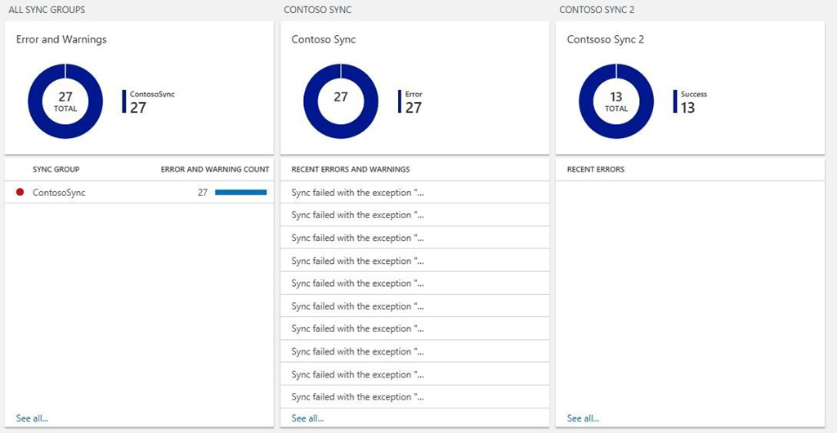
Monitor SQL Data Sync with Azure Monitor logs (I/II)
Monitor all your Sync Groups from any of your subscriptions in one place by using a custom Azure Monitor view.
Notes:
To check the SQL Data Sync activity log and detect errors and warnings, you previously had to check SQL Data Sync manually in the Azure portal, or use PowerShell or the REST API. Follow the steps in this article to configure a custom solution that improves the Data Sync monitoring experience. You can customize this solution to fit your scenario.
For an overview of SQL Data Sync, see Sync data across multiple cloud and on-premises databases with Azure SQL Data Sync.

Slide 49
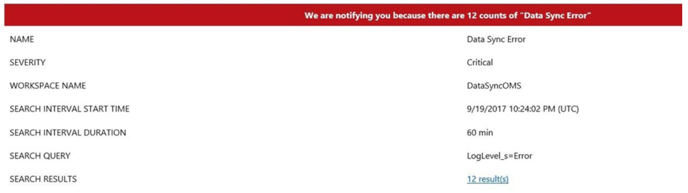
Monitor SQL Data Sync with Azure Monitor logs (II/II)
Monitor all your Sync Groups from any of your subscriptions in one place by using a custom Azure Monitor view.
It also includes automated email notifications.
Notes:
To check the SQL Data Sync activity log and detect errors and warnings, you previously had to check SQL Data Sync manually in the Azure portal, or use PowerShell or the REST API. Follow the steps in this article to configure a custom solution that improves the Data Sync monitoring experience. You can customize this solution to fit your scenario.
For an overview of SQL Data Sync, see Sync data across multiple cloud and on-premises databases with Azure SQL Data Sync.

Slide 50
How do you set up these monitoring features with Azure Monitor logs?
You need to configure three components:
A PowerShell runbook to feed SQL Data Sync log data to Azure Monitor logs.
An Azure Monitor alert for email notifications.
An Azure Monitor View for monitoring.
Notes:
Implement a custom Azure Monitor logs monitoring solution for SQL Data Sync in less than an hour by doing the following things:
You need to configure three components:
Azure Automation: There may be a cost incurred with the Azure Automation account, depending on your usage. The first 500 minutes of job run time per month are free. In most cases, this solution is expected to use less than 500 minutes per month. To avoid charges, schedule the runbook to run at an interval of two hours or more. For more info, see Automation pricing.
Automated Email notifications
You can create alerts that go directly to the email addresses of the people that need to see them when an error occurs
Azure Monitor logs: There may be a cost associated with Azure Monitor logs depending on your usage. The free tier includes 500 MB of ingested data per day. In most cases, this solution is expected to ingest less than 500 MB per day. To decrease the usage, use the failure-only filtering included in the runbook. If you are using more than 500 MB per day, upgrade to the paid tier to avoid the risk of analytics stopping when the limitation is reached. For more info, see Azure Monitor logs pricing.

Slide 51
Demonstration
Setup Azure SQL Data Sync
Setup Azure SQL Data Sync between on-premises database and Azure SQL Database
Notes:
M06L06Demo01
Demo requirements
The pubs that you have created in the Lab Migrate a Compatible SQL Server Database to Azure SQL Database
Create a new blank database “pubsMember” on your logical server
SQL Azure Data Sync Agent : SQLDataSyncAgent-2.0-x86-ENU.msi and DataSyncAgent_LicenseTerms.rtf - https://www.microsoft.com/en-us/download/details.aspx?id=27693
See also next slides with screenshots

Slide 52
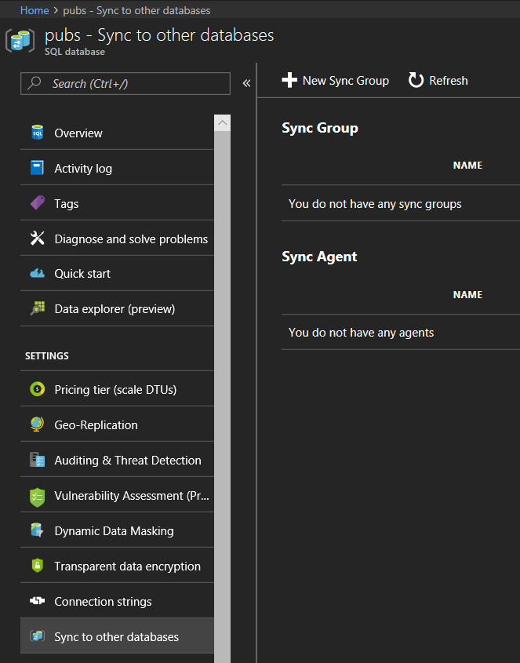
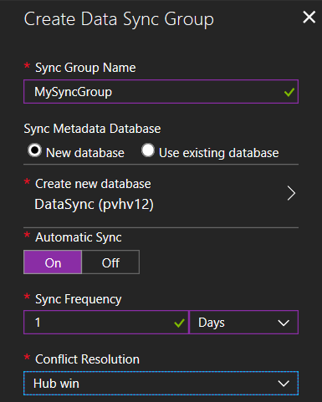
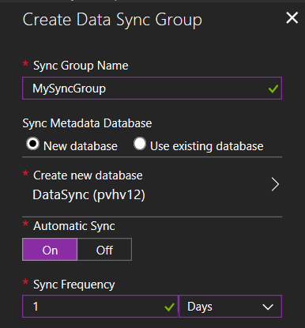
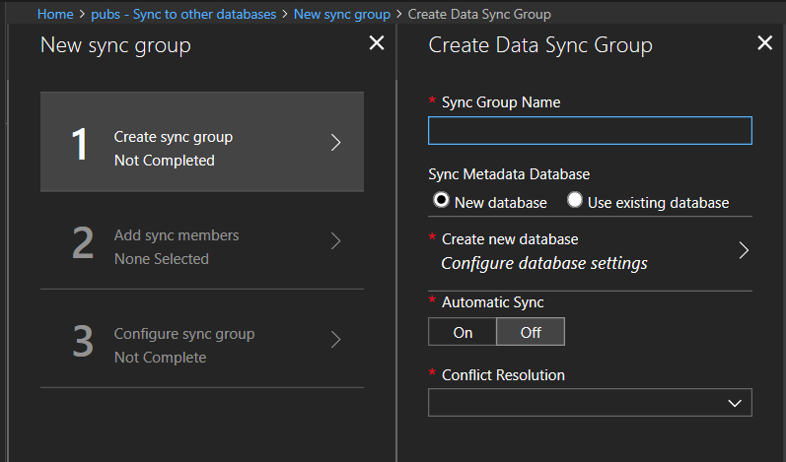
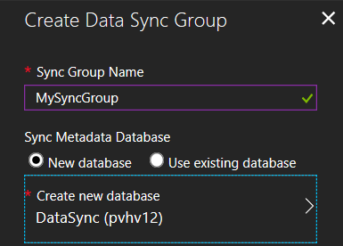
Step 1 – Create Data Sync Group
Sync to other databases.
Create new Sync Group.
Specify Data Sync Group Name.
Create New Sync Metadata DB.
Enable Automatic Sync & Sync Frequency.
Select Conflict Resolution.
Notes:
Locate the Data Sync settings
In your browser, navigate to the Azure portal.
In the portal, locate your SQL databases from your Dashboard or from the SQL Databases icon on the toolbar.
On the SQL databases page, select the existing SQL database that you want to use as the hub database for Data Sync. The SQL database page opens.
On the SQL database page for the selected database, select Sync to other databases. The Data Sync page opens.
On the Data Sync page, select New Sync Group. The New sync group page opens with Step 1, Create sync group, highlighted. The Create Data Sync Group page also opens.
On the Create Data Sync Group page, do the following things:
In the Sync Group Name field, enter a name for the new sync group.
In the Sync Metadata Database section, choose whether to create a new database (recommended) or to use an existing database.
Note
Microsoft recommends that you create a new, empty database to use as the Sync Metadata Database. Data Sync creates tables in this database and runs a frequent workload. This database is automatically shared as the Sync Metadata Database for all of your Sync groups in the selected region. You can't change the Sync Metadata Database or its name without dropping it.
If you chose New database, select Create new database. The SQL Database page opens. On the SQL Database page, name and configure the new database. Then select OK.
If you chose Use existing database, select the database from the list.
In the Automatic Sync section, first select On or Off.
If you chose On, in the Sync Frequency section, enter a number and select Seconds, Minutes, Hours, or Days.
In the Conflict Resolution section, select "Hub wins" or "Member wins."
Select OK and wait for the new sync group to be created and deployed.

Slide 53
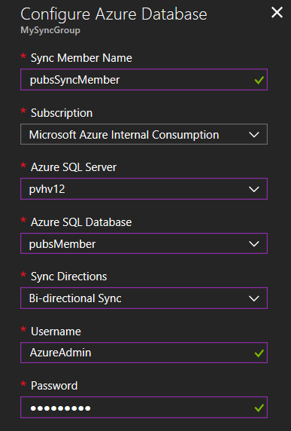
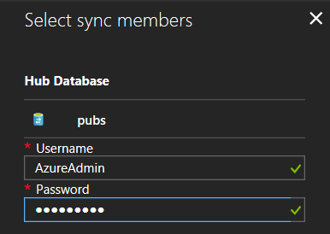
Step 2 – Add Sync Members – Azure DB
Enter the existing credentials.
Specify the name for the new sync member.
Select the Subscription.
Select the existing SQL database server.
Select the existing SQL database.
Specify the Sync Directions.
Notes:
Add an Azure SQL Database
In the Member Database section, optionally add an Azure SQL Database to the sync group by selecting Add an Azure Database. The Configure Azure Database page opens.
On the Configure Azure Database page, do the following things:
In the Sync Member Name field, provide a name for the new sync member. This name is distinct from the name of the database itself.
In the Subscription field, select the associated Azure subscription for billing purposes.
In the Azure SQL Server field, select the existing SQL database server.
In the Azure SQL Database field, select the existing SQL database.
In the Sync Directions field, select Bi-directional Sync, To the Hub, or From the Hub.
In the Username and Password fields, enter the existing credentials for the SQL Database server on which the member database is located. Don't enter new credentials in this section.
Select OK and wait for the new sync member to be created and deployed.

Slide 54
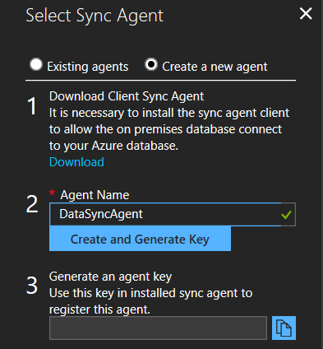
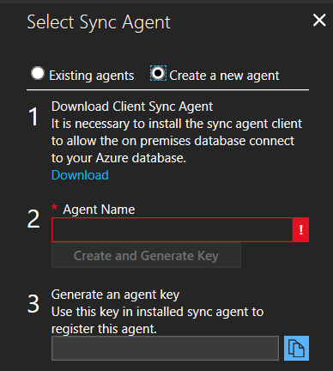
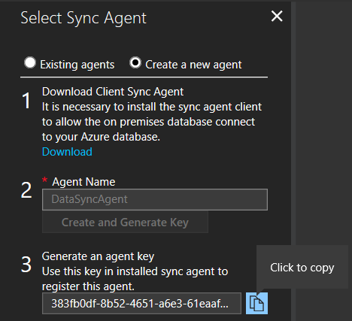
Step 2 – Add Sync Members – On-premises DB
Choose the Sync Agent Gateway.
Download the Client Sync Agent & install on the SQL Server.
Enter a name for the Agent.
Select Create and Generate Key.
Copy the agent key to the clipboard.
Notes:
Add an on-premises SQL Server database
In the Member Database section, optionally add an on-premises SQL Server to the sync group by selecting Add an On-Premises Database. The Configure On-Premises page opens.
On the Configure On-Premises page, do the following things:
Select Choose the Sync Agent Gateway. The Select Sync Agent page opens.
On the Choose the Sync Agent Gateway page, choose whether to use an existing agent or create a new agent.
If you chose Existing agents, select the existing agent from the list.
If you chose Create a new agent, do the following things:
Download the client sync agent software from the link provided and install it on the computer where the SQL Server is located.
Important
You have to open outbound TCP port 1433 in the firewall to let the client agent communicate with the server.
Enter a name for the agent.
Select Create and Generate Key.
Copy the agent key to the clipboard.
Select OK to close the Select Sync Agent page.

Slide 55
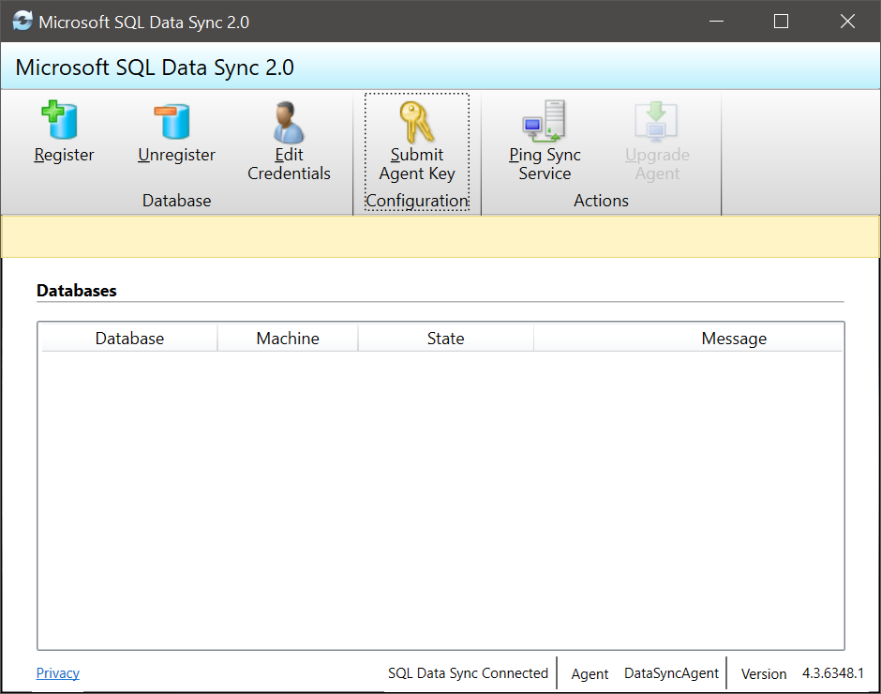
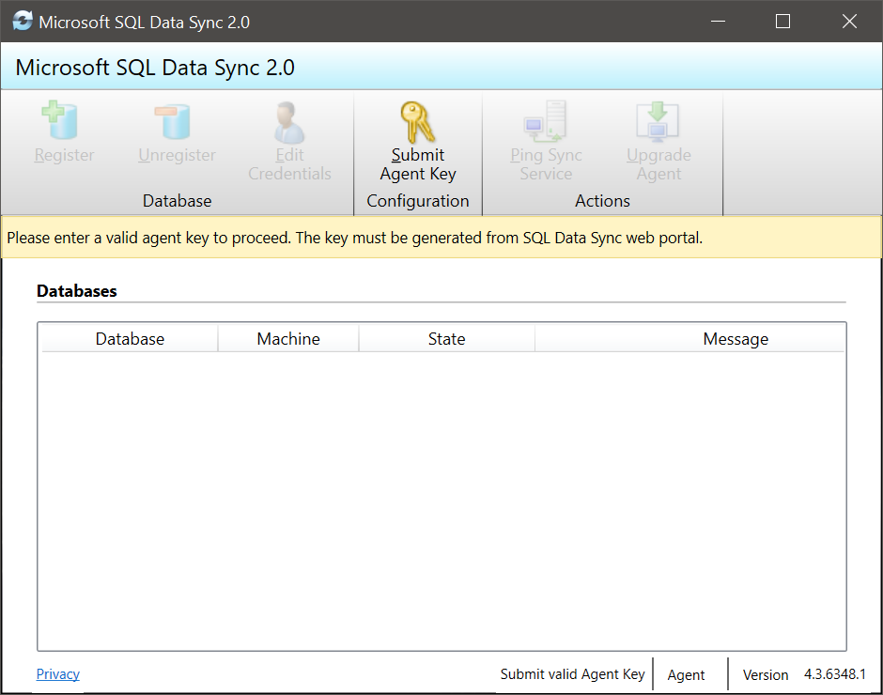
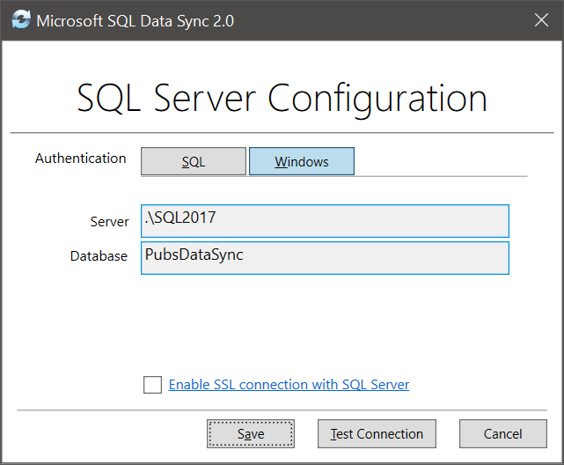
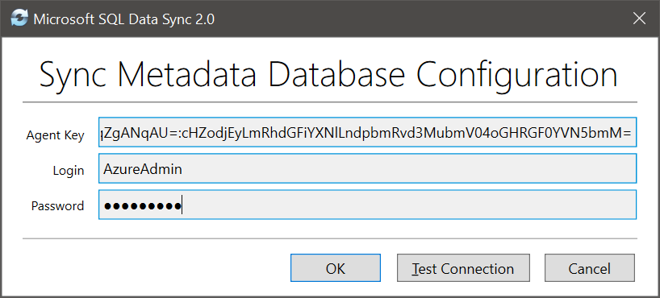
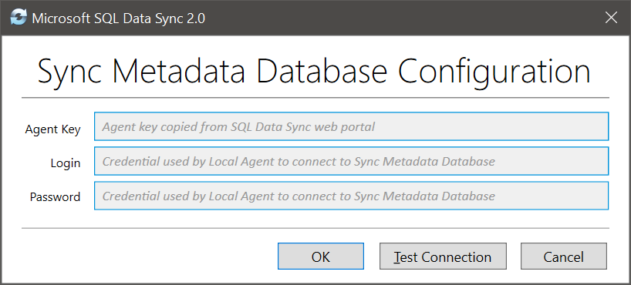
Step 2 – Add Sync Members – On-premises DB
Launch Client Sync Agent app.
Submit Agent Key.
Paste the agent Key.
Provide credentials for the metadata database.
Click Register to register a SQL Server database with the agent.
Provide the SQL Server name and the name of the database that you want to sync.
Notes:
On the SQL Server computer, locate and run the Client Sync Agent app.
In the sync agent app, select Submit Agent Key. The Sync Metadata Database Configuration dialog box opens.
In the Sync Metadata Database Configuration dialog box, paste in the agent key copied from the Azure portal. Also provide the existing credentials for the Azure SQL Database server on which the metadata database is located. (If you created a new metadata database, this database is on the same server as the hub database.) Select OK and wait for the configuration to finish.
Note
If you get a firewall error at this point, you have to create a firewall rule on Azure to allow incoming traffic from the SQL Server computer. You can create the rule manually in the portal, but you may find it easier to create it in SQL Server Management Studio (SSMS). In SSMS, try to connect to the hub database on Azure. Enter its name as <hub_database_name>.database.windows.net. To configure the Azure firewall rule, follow the steps in the dialog box. Then return to the Client Sync Agent app.
In the Client Sync Agent app, click Register to register a SQL Server database with the agent. The SQL Server Configuration dialog box opens.
In the SQL Server Configuration dialog box, choose whether to connect by using SQL Server authentication or Windows authentication. If you chose SQL Server authentication, enter the existing credentials. Provide the SQL Server name and the name of the database that you want to sync. Select Test connection to test your settings. Then select Save. The registered database appears in the list.
You can now close the Client Sync Agent app.

Slide 56
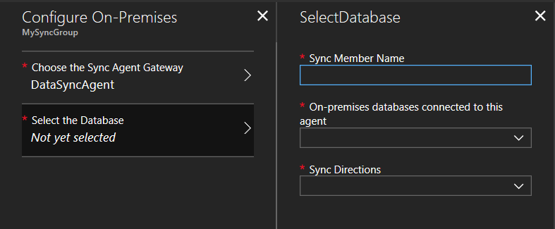
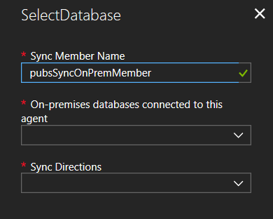
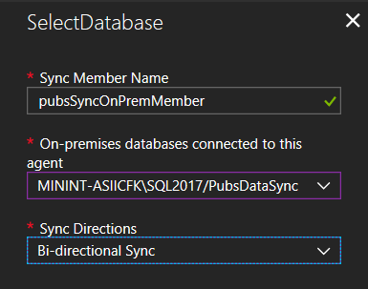
Step 2 – Add Sync Members – On-premises DB
Select the Database.
Provide a name for the new sync member.
Specify the on-premises agent.
Specify the Sync Directions.
Notes:
In the portal, on the Configure On-Premises page, select Select the Database. The Select Database page opens.
On the Select Database page, in the Sync Member Name field, provide a name for the new sync member. This name is distinct from the name of the database itself. Select the database from the list. In the Sync Directions field, select Bi-directional Sync, To the Hub, or From the Hub.
Select OK to close the Select Database page. Then select OK to close the Configure On-Premises page and wait for the new sync member to be created and deployed. Finally, click OK to close the Select sync members page.
To connect to SQL Data Sync and the local agent, add your user name to the role DataSync_Executor. Data Sync creates this role on the SQL Server instance.

Slide 57


Step 3 – Configure sync group
Select a member database & Refresh Schema.
Select the tables that you want to sync.
Click Save.
Notes:
Step 3 - Configure sync group
After the new sync group members are created and deployed, Step 3, Configure sync group, is highlighted in the New sync group page.
On the Tables page, select a database from the list of sync group members, and then select Refresh schema.
From the list of available tables, select the tables that you want to sync.
By default, all columns in the table are selected. If you don't want to sync all the columns, disable the checkbox for the columns that you don't want to sync. Be sure to leave the primary key column selected.
Finally, select Save.
Manually Sync
Go to your Sync Group and click on the Sync Button
Wait until the sync is finished and press the Refresh Logs Button to follow the process
se the SSMS to update a record in the jobs table on the hub database
SELECT * FROM [dbo].[jobs] WHERE job_id = 1
UPDATE [dbo].[jobs] SET [min_lvl] = 25 WHERE job_id = 1
Go back to the portal and press the Sync button again.
Verify if the record was replicated.
SELECT * FROM [dbo].[jobs] WHERE job_id = 1
Update a second record on the on-premises database
UPDATE [dbo].[jobs] SET [max_lvl] = 150 WHERE job_id = 1
Go back to the portal and press the Sync button again.
Verify if the record was replicated.
SELECT * FROM [dbo].[jobs] WHERE job_id = 1

Slide 58
Setup Azure SQL Data Sync (if time permits)
Setup Azure SQL Data Sync between Azure SQL Databases.
Notes:
M06L06Lab01

Slide 59
Questions?

Slide 60
Knowledge Check
Which databases are part of a Sync Group?
Which options can you use to resolve Conflicts?
What are the three main steps to setup Data Sync?
Notes:
Q1: Which databases are part of a Sync Group?
Answer 1:
The Hub Database must be an Azure SQL Database.
The member databases can be either SQL Databases, on-premises SQL Server databases, or SQL Server instances on Azure virtual machines.
The Sync Database contains the metadata and log for Data Sync. The Sync Database has to be an Azure SQL Database located in the same region as the Hub Database. The Sync Database is customer created and customer owned.
Q2: Which options can you use to resolve Conflicts?
Answer 2:
Resolving conflicts: Data Sync provides two options for conflict resolution, Hub wins or Member wins.
If you select Hub wins, the changes in the hub always overwrite changes in the member.
If you select Member wins, the changes in the member overwrite changes in the hub. If there's more than one member, the final value depends on which member syncs first.
Q3: What are the 3 main steps to setup Data Sync?
Answer 3:
Step 1 - Create sync group
Step 2 – Add Sync Members
Step 3 – Configure sync group

Slide 61
Module Summary
Migration steps
Verify your Database for Compatibility Issues
Fixing Compatibility Issues
Identify the right Azure SQL Database SKU
Migration
Sync across multiple cloud and on-premises databases

Slide 62


